Slide 1
MEMORY MANAGEMENT
(PAGING & SEGMENTATION)

Slide 2
Memory Management Techniques
Contiguous
Non-Contiguous
In contiguous memory allocation, each process is allocated a single contiguous block of memory.
This method requires that all memory for a process be stored in one continuous section, making it simpler to manage and access.
Example: - Fixed Partitioning - Dynamic Partitioning
In non-contiguous memory allocation, processes are allocated in various non-contiguous blocks.
This method does not require all memory for a process to be stored in one continuous section, they can be stored anywhere in the memory.
Example: - Paging - Segmentation

Slide 3
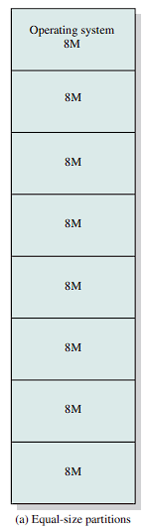
What is Fixed Partitioning?
Fixed partitioning is an early method used in memory management where memory is divided into fixed-size blocks or partitions.
Each block can hold only one process, and the size of block remains static throughout the system's operation.
It is simple to implement but it has internal fragmentation due to fixed number of processes.
Inefficient memory utilization because the processes that are smaller than the block size waste memory.

Slide 4
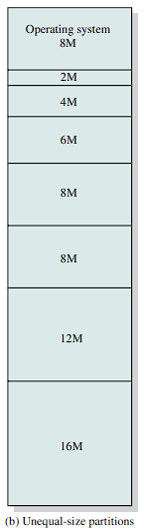
What is Dynamic Partitioning?
Dynamic partitioning is a memory management method where memory is allocated dynamically to processes as needed.
Unlike fixed partitions, the size of each partition varies based on the process requirements.
Since partitions are created according to the exact size of the process, there is no internal fragmentation.
Over time, as processes are loaded and removed, memory becomes fragmented, leaving small gaps between partitions that may not be usable.

Slide 5
Key Difference
Internal Fragmentation
External Fragmentation
It occurs when allocated partitions have unused space because the loaded data is smaller than the partition size, resulting in wasted memory within the partition.
Example: Fixed-sized partitioning where partitions or blocks are pre-defined and cannot adjust to the exact size of a process.
It occurs when free spaces between partitions are created due to dynamic memory allocations, leaving gaps too small for new processes to fit in the memory.
Example: Dynamic partitioning where partitions are created dynamically, but free memory becomes scattered over time

Slide 6
Important Terms
A page is a fixed-size block of data stored in secondary memory (like a hard drive). When needed, a page can be temporarily loaded into a frame in the main memory (RAM) for processing.
A frame is a fixed-size block of main memory (RAM) where pages from secondary memory are stored. Each frame holds one page at a time.

Slide 7
Understanding Address Types
A Logical Address reference to memory location, independent of the current assignment of data to memory. A translation must be made to a physical address before the memory access can be achieved.
A Physical Address (absolute address) is the actual location in the memory.

Slide 8
Concept of Paging
Paging improves memory usage by dividing main memory into equal-sized blocks called frames and processes into equal-sized chunks called pages, minimizing both internal and external fragmentation.
The operating system maintains a list of free frames (holes) and manages the allocation of pages to these frames as each process is loaded using its own page table that maps logical page numbers to physical frame locations.
Logical addresses consist of a page number and an offset within that page, enabling the processor to translate addresses accurately and efficiently access memory.
When a new process requires loading, the operating system can utilize available frames, even if they are not contiguous, showcasing the flexibility of paging.

Slide 9
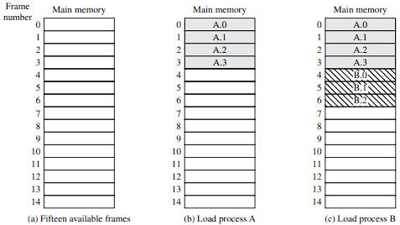
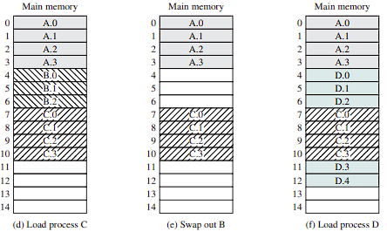
Example:

Slide 10
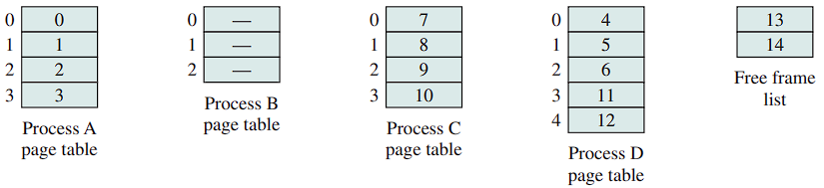
Page Table
The operating system maintains a page table for each process. The page table shows the frame location for each page of the process.
Within the program, each logical address consists of a page number and an offset within the page.
Presented with a logical address (page number, offset), the processor uses the page table to produce a physical address (frame number, offset).

Slide 11
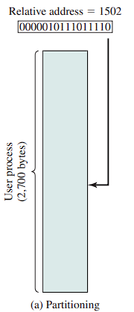

Slide 12
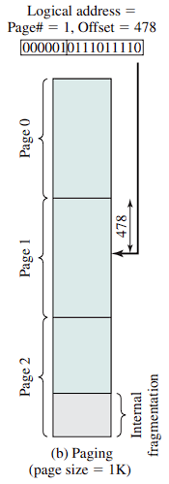

Slide 13
Paging: Address Translation Process
Extract the page number as the leftmost n bits of the logical address.
Use the page number as an index into the process page table to find the frame number, k.
The starting physical address of the frame is k × 2ₘ , and the physical address of the referenced byte is that number plus the offset. This physical address need not be calculated; it is easily constructed by appending the frame number to the offset.

Slide 14
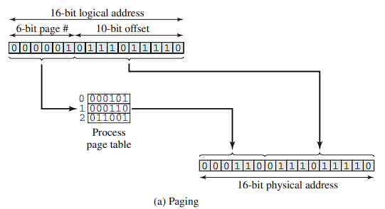
Examples of Logical to Physical Address Translation

Slide 15
To Summarize Paging
Main memory is divided into many small equal-size frames.
Each process is divided into frame-size pages.
Smaller processes require fewer pages; larger processes require more.
When a process is brought in, all its pages are loaded into available frames, and a page table is set up.
This approach solves many of the problems inherent in partitioning.

Slide 16
Concept of Segmentation
A user program can be subdivided using segmentation, where the program and its data are divided into segments of unequal lengths, subject to a maximum segment length.
A logical address in segmentation consists of a segment number and an offset.
Segmentation is similar to dynamic partitioning, allowing a program to occupy multiple non-contiguous partitions.
It eliminates internal fragmentation but suffers from external fragmentation, though this is generally less severe due to smaller segments.
Segmentation is visible to the programmer, providing a way to organize programs and data, with the programmer or compiler assigning them to segments

Slide 17
Continue…
The maximum segment size limitation is a key consideration for programmers.
There is no simple relationship between logical and physical addresses; a segment table for each process is used to map segments to starting addresses in memory.
Each segment table entry includes the starting address and length of the segment to prevent invalid addresses.
Logical addresses consist of n bits for the segment number and m bits for the offset, allowing for a maximum segment size of 2^m.

Slide 18
Segmentation vs Dynamic Partitioning
The difference compared to dynamic partitioning is that, with segmentation, a program may occupy more than one partition, and these partitions need not be contiguous.
Segmentation eliminates internal fragmentation but, like dynamic partitioning, it suffers from external fragmentation.

Slide 19
Segmentation: Address Translation Process
Extract the segment number as the leftmost n bits of the logical address.
Use the segment number as an index into the process segment table to find the starting physical address of the segment.
Compare the offset, expressed in the rightmost m bits, to the length of the segment. If the offset is greater than or equal to the length, the address is invalid.
The desired physical address is the sum of the starting physical address of the segment plus the offset.

Slide 20
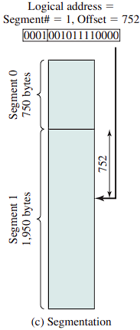

Slide 21
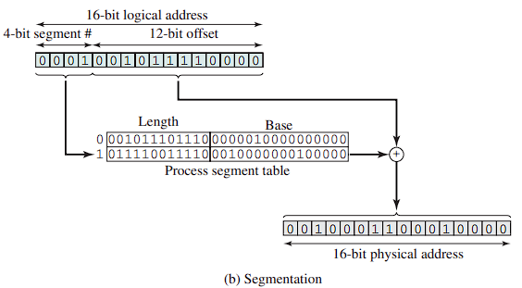
Examples of Logical to Physical Address Translation

Slide 22
THANK YOU
Group 02:
Wahab Tariq – B21110006163
Hassan Adil Yousuf – B21110006040
M. Saqlain - B21110006089
Qambar Ali - B20102134

